Slide 1
Fundamentals of Python: First Programs Second Edition
Graphical User Interfaces

Slide 2
Objectives
8.1 Design and code a G U I-based program
8.2 Define a new class using subclassing and inheritance
8.3 Instantiate and lay out different types of window objects, such as labels, entry fields, and command buttons, in a window’s frame
8.4 Define methods that handle events associated with window objects
8.5 Organize sets of window objects in nested frames

Slide 3
Introduction
Most modern computer software employs a graphical user interface or G U I
A G U I displays text as well as small images (called icons) that represent objects such as directories, files of different types, command buttons, and drop-down menus
In addition to entering text at keyboard, the user of a G U I can select an icon with pointing device, such as mouse, and move that icon around on the display

Slide 4
The Behavior of Terminal-Based Programs and G U I-Based Programs
Two different versions of the same program from a user’s point of view:
Terminal-based user interface
Graphical user interface
Both programs perform exactly the same function
However, their behavior, or look and feel, from a user’s perspective are quite different

Slide 5
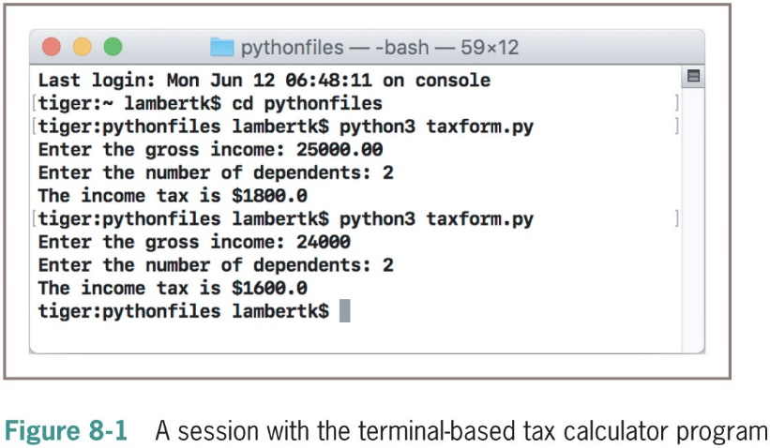
Terminal-Based Version
Terminal-based user interface has several effects on its users:
User is constrained to reply to a definite sequence of prompts for inputs
Once an input is entered, there is no way to change it
To obtain results for a different set of input data, user must wait for command menu to be displayed again
At that point, the same command and all of the other inputs must be re-entered

Slide 6
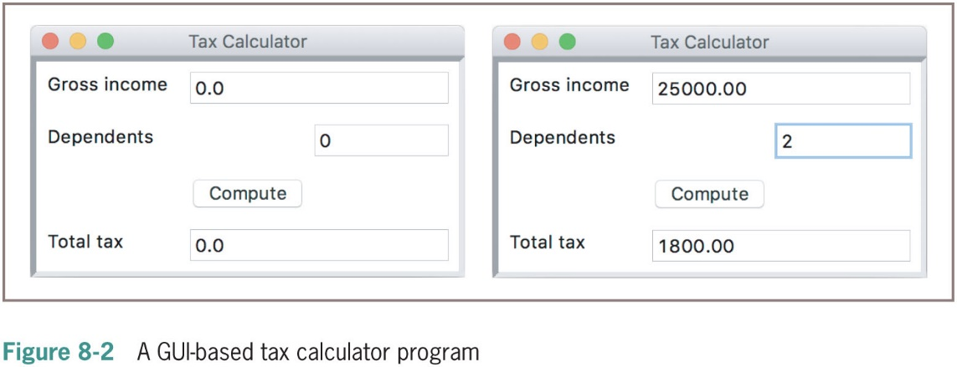
The G U I-Based Version (1 of 2)
G U I-based version displays a window that contains various components
Called window objects or widgets

Slide 7
The G U I-Based Version (2 of 2)
G U I-based version has the following effects on users:
User is not constrained to enter inputs in a particular order
Before pressing the Compute button, user can edit any of the data
Running different data sets does not require re-entering all of the data
G U I seems to be a definite improvement on the terminal-based user interface

Slide 8
Event-Driven Programming
User-generated events (e.g., mouse clicks) trigger operations in program to respond by pulling in inputs, processing them, and displaying results
Event-driven software
Event-driven programming
Coding phase:
Define a new class to represent the main window
Instantiate the classes of window objects needed for this application (e.g., labels, command buttons)
Position these components in the window
Instantiate the data model and provide any default data in the window objects
Register controller methods with each window object in which a relevant event might occur
Define these controller methods
Define a main that launches the G U I

Slide 9
Coding Simple G U I-Based Programs
There are many libraries and toolkits of G U I components available to the Python programmer
tk inter includes classes for windows and numerous types of window objects
breezy python gui a custom, open-source module

Slide 10
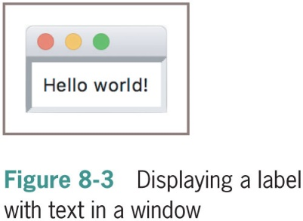
A Simple “Hello World” Program
A new window class extends the EasyFrame class
The EasyFrame class provides the basic functionality for any window
“““
File: labeldemo.py
”””
from breezy python gui import EasyFrame
class LabelDemo(EasyFrame):
“““Displays a greeting in a window.”””
def __init__(self):
“““Sets up the window and the label.”””
EasyFrame.__init__(self)
self.addLabel(text = “Hello world!”, row = 0, column = 0)
def main():
“““Instantiates and pops up the window.”””
LabelDemo().mainloop()
if __name__ == “__main__”:
main()

Slide 11
A Template for All G U I Programs
The structure of a G U I program is always the same, so there is a template:
from breezypythongui import EasyFrame
Other imports
class ApplicationName(EasyFrame):
The __init__ method definition
Definitions of event handling methods
def main():
ApplicationName().mainloop()
if __name__ == "__main__":
main()

Slide 12
The Syntax of Class and Method Definitions
Each definition has a one-line header that begins with a keyword (class or def)
Followed by a body of code indented one level in the text
A class header contains the name of the class followed by a parenthesized list of one or more parent classes
The body, nested one tab under the header, consists of one or more method definitions
A method header looks like a function header
But a method always has at least one parameter named self

Slide 13
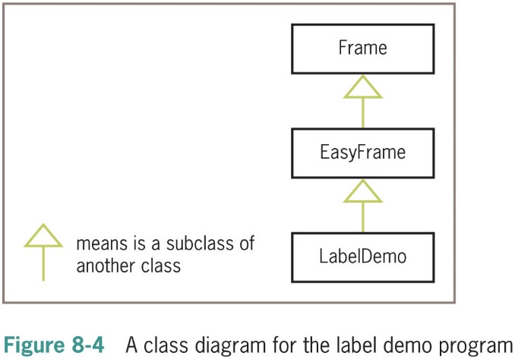
Subclassing and Inheritance as Abstraction Mechanisms

Slide 14
Windows and Window Components
This section explores the details of windows and window components
You will also learn how to:
Choose appropriate classes of G U I objects
Access and modify their attributes
Organize them to cooperate to perform the task at hand

Slide 15
Windows and Their Attributes (1 of 2)
Most important attributes:
Title (an empty string by default)
Width and height in pixels
Resizability (true by default)
Background color (white by default)
Example of overriding dimensions and title:
EasyFrame.__init__(self, width = 300, height = 200,
title = “Label Demo”)
See Table 8-1 for other methods to change a window’s attributes

Slide 16
Windows and Their Attributes (2 of 2)
EasyFrame Method | What It Does
setBackground(color) | Sets the window’s background color to color
setResizable(aBoolean) | Makes the window resizable (True) or not (False)
setSize(width, height) | Sets the window’s width and height in pixels
setTitle(title) | Sets the window’s title to title

Slide 17
Window Layout (1 of 4)
Window components are laid out in the window’s two-dimensional grid
Rows and columns are numbered from the position (0,0) in the upper left corner of the window
Example:
class LayoutDemo(EasyFrame):
“““Displays labels in the quadrants.”””
def __init__(self):
“““Sets up the window and the labels.”””
EasyFrame.__init__(self)
self.addLabel(text = “(0, 0)”, row = 0, column = 0)
self.addLabel(text = “(0, 1)”, row = 0, column = 1)
self.addLabel(text = “(1, 0)”, row = 1, column = 0)
self.addLabel(text = “(1, 1)”, row = 1, column = 1)

Slide 18
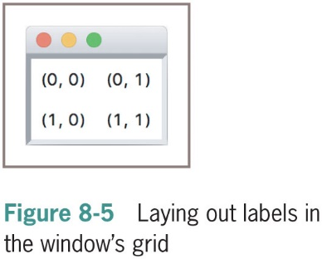
Window Layout (2 of 4)

Slide 19
Window Layout (3 of 4)
Each type of window component has a default alignment
Programmers can override the default alignment by including the sticky attribute as a keyword argument:
self.addLabel(text = “(0, 0)”, row = 0, column = 0,
sticky = “N S E W”)
self.addLabel(text = “(0, 1)", row = 0, column = 1,
sticky = "N S E W”)
self.addLabel(text = “(1, 0)", row = 1, column = 0,
sticky = "N S E W”)
self.addLabel(text = “(1, 1)”, row = 1, column = 1,
sticky = “N S E W”)

Slide 20
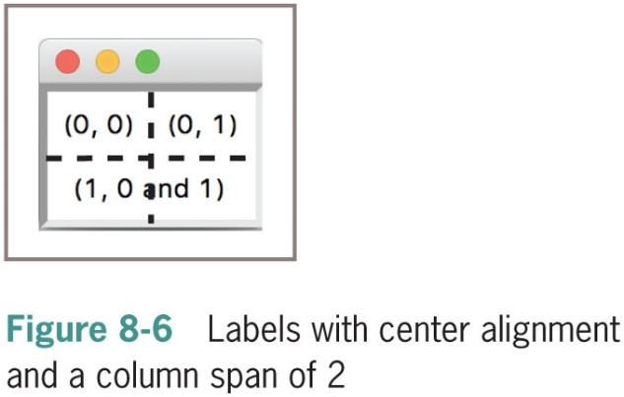
Window Layout (4 of 4)
An aspect of window layout involves the spanning of a window component across several grid positions
The programmer can force a horizontal and/or vertical spanning of grid positions by supplying the rowspan and columnspan keyword arguments
self.addLabel(text = “(0, 0)”, row = 0, column = 0,
sticky = “N S E W”)
self.addLabel(text = “(0, 1)”, row = 0, column = 1,
sticky = “N S E W”)
self.addLabel(text = “(1, 0 and 1)”, row = 1, column = 0,
sticky = “N S E W”, columnspan = 2)

Slide 21
Types of Window Components and Their Attributes
breezy python gui includes methods for adding each type of window component to a window
Each method uses the form:
self.addComponentType(<arguments>)
When this method is called, breezy python gui
Creates an instance of the requested type of window component
Initializes the component’s attributes with default values or any values provided by the programmer
Places the component in its grid position (the row and column are required arguments)
Returns a reference to the component

Slide 22
Displaying Images (1 of 3)
The image label is first added to the window with an empty string
Program then creates a PhotoImage object from an image file and sets the image attribute of the image label to this object
The program creates a Font object with a non-standard font and resets the text label’s font and foreground attributes to obtain the caption shown in Figure 8-7
Code:
from breezypythongui import EasyFrame
from tkinter import PhotoImage
from tkinter.font import Font
class ImageDemo(EasyFrame):
“““Displays an image and a caption.”””

Slide 23
Displaying Images (2 of 3)
Code (continued):
def __init__(self):
“““Sets up the window and the widgets.”””
EasyFrame.__init__(self, title = “Image Demo”)
self.setResizable(False);
imageLabel = self.addLabel(text = “ ”,
row = 0, column = 0,
sticky = “N S E W”)
textLabel = self.addLabel(text = “Smokey the cat”,
row = 1, column = 0,
sticky = “N S E W”)
# Load the image and associate it with the image label.
self.image = PhotoImage(file = “smokey.gif”)
imageLabel[“image”] = self.image
# Set the font and color of the caption.
font = Font(family = “Verdana”, size = 20,
slant = “italic”)
textLabel["font”] = font
textLabel[“foreground”] = “blue”

Slide 24
Displaying Images (3 of 3)
Label Attribute | Type of Value
image | A PhotoImage object (imported from tkinter.font)
text | A string
background | A color
foreground | A color (color of text)
font | A Font object (imported from tkinter.font)

Slide 25
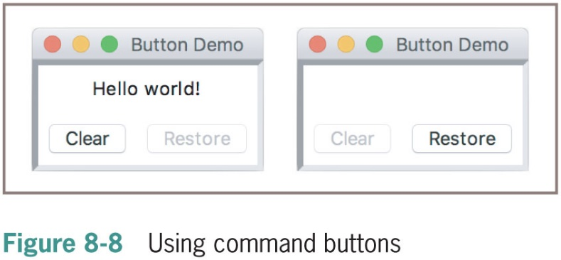
Command Buttons and Responding to Events (1 of 2)
A command button is added to a window just like a label
By specifying its text and position in the grid
A button is centered in its grid position by default
The method addButton accomplishes all this and returns an object of type tkinter.Buttton
Figure 8-8 shows these two states of the window, followed by the code for the initial version of the program

Slide 26
Command Buttons and Responding to Events (2 of 2)
class ButtonDemo(EasyFrame):
“““Illustrates command buttons and user events.”””
def __init__(self):
“““Sets up the window, label, and buttons.”””
EasyFrame.__init__(self)
# A single label in the first row.
self.label = self.addLabel(text = “Hello world!”,
row = 0, column = 0,
columnspan = 2,
sticky = “NSEW”)
# Two command buttons in the second row.
self.clearBtn = self.addButton(text = “Clear”,
row = 1, column = 0)
self.restoreBtn = self.addButton(text = “Restore”,
row = 1, column = 1,
state = “disabled”)

Slide 27
Input and Output with Entry Fields
Entry field
A box in which the user can position the mouse cursor and enter a number or a single line of text
This section explores the use of entry fields to allow a G U I program to take input text or numbers from a user
And display text or numbers as input

Slide 28
Text Fields (1 of 3)
Text field
Appropriate for entering or displaying a single-line string of characters
Programmers use the method addTextField to add a text field to a window
The method returns an object of type TextField, which is subclass of tkinter.Entry
Required arguments to addTextField are:
Text, row, and column
Optional arguments are rowspan, columnspan, sticky, width, and state

Slide 29
Text Fields (2 of 3)
Code:
class TextFieldDemo(EasyFrame):
“““ Converts an input string to uppercase and displays
the result. ”””
def __init__(self):
“““ Sets up the window and widgets.”””
EasyFrame.__init__(self, title = “Text Field Demo”)
# Label and field for the input
self.addLabel(text = “Input”, row = 0, column = 0)
self.inputField = self.addTextField(text = “ ”,
row = 0,
column = 1)
# Label and field for the output
self.addLabel(text = “Output”, row = 1, column = 0)
self.outputField = self.addTextField(text = “ ”,
row = 1,
column = 1,
state = “readonly”)

Slide 30
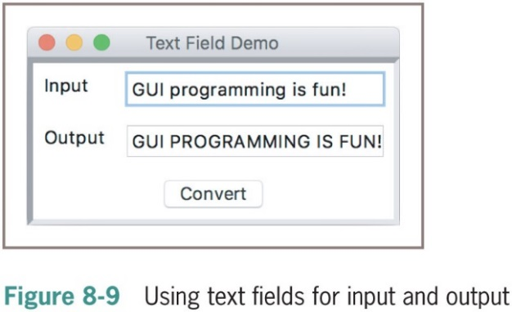
Text Fields (3 of 3)
Code (continued):
# The command button
self.addButton(text = "Convert", row = 2, column = 0,
columnspan = 2, command = self.convert)
# The event handling method for the button
def convert(self):
“““ Inputs the string, converts it to uppercase,
and outputs the result.”””
text = self.inputField.getText()
result = text.upper()
self.outputField.setText(result)

Slide 31
Integer and Float Fields for Numeric Data (1 of 4)
breezy”python gui includes two types of data fields for the input and output of integers and floating-point numbers:
IntegerField and FloatField
Similar in usage to the method addTextField
However, instead of an initial text attribute, the programmer supplies a value attribute
The method addFloatField allows an optional precision argument
The methods getNumber and setNumber are used for the input and output of numbers with integer and float fields

Slide 32
Integer and Float Fields for Numeric Data (2 of 4)
Code:
class NumberFieldDemo(EasyFrame):
“““ Computes and displays the square root of an
input number.”””
def __init__(self):
“““Sets up the window and widgets.”””
EasyFrame.__init__(self, title = “Number Field Demo”)
# Label and field for the input
self.addLabel(text = “An integer”,
row = 0, column = 0)
self.inputField = self.addIntegerField(value = 0,
row = 0,
column = 1,
width = 10)
# Label and field for the output
self.addLabel(text = “Square root”,
row = 1, column = 0)

Slide 33
Integer and Float Fields for Numeric Data (3 of 4)
Code (continued):
self.outputField = self.addFloatField(value = 0.0,
row = 1,
column = 1,
width = 8,
precision = 2,
state = “readonly”)
# The command button
self.addButton(text = “Compute”, row = 2, column = 0,
columnspan = 2,
command = self.computeSqrt)
# The event handling method for the button
def computeSqrt(self):
“““Inputs the integer, computes the square root,
and outputs the result.”””
number = self.inputField.getNumber()
result = math.sqrt(number)
self.outputField.setNumber(result)

Slide 34
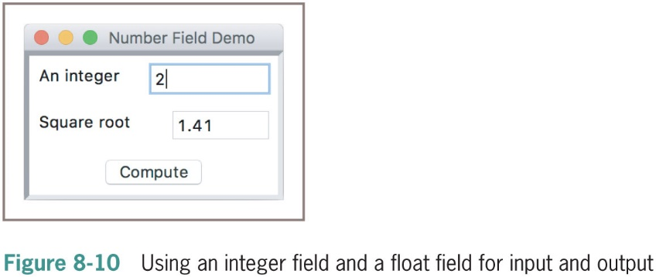
Integer and Float Fields for Numeric Data (4 of 4)

Slide 35
Using Pop-Up Message Boxes (1 of 2)
When errors arise in a G U I-based program
Program often responds by popping up a dialog window with an error message
Code:
# The event handling method for the button
def computeSqrt(self):
“““Inputs the integer, computes the square root,
and outputs the result. Handles input errors
by displaying a message box.”””
try:
number = self.inputField.getNumber()
result = math.sqrt(number)
self.outputField.setNumber(result)
except ValueError:
self.messageBox(title = “ERROR”,
message = “Input must be an integer >= 0”)

Slide 36
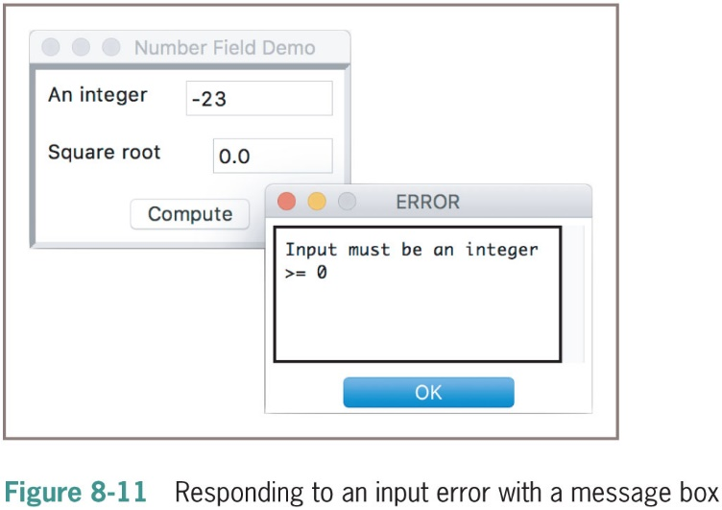
Using Pop-Up Message Boxes (2 of 2)

Slide 37
Defining and Using Instance Variables (1 of 4)
Instance variable
Used to store data belonging to an individual object
The values of an object’s instance variables make up its state
Example: the state of a given window includes its title, background color, and dimensions, among other things
When you customize an existing class
You can add to the state of its objects by including new instance variables
Define these new variables (which must begin with the name self) within the class’s _init_ method

Slide 38
Defining and Using Instance Variables (2 of 4)
Code example:
class CounterDemo(EasyFrame):
“““ Illustrates the use of a counter with an
instance variable. ”””
def __init__(self):
“““Sets up the window, label, and buttons.”””
EasyFrame.__init__(self, title = “Counter Demo”)
self.setSize(200, 75)
# Instance variable to track the count.
self.count = 0
# A label to display the count in the first row.
self.label = self.addLabel(text = “0”,
row = 0, column = 0,
sticky = “N S E W”,
columnspan = 2)

Slide 39
Defining and Using Instance Variables (3 of 4)
Code example (continued):
# Two command buttons.
self.addButton(text = “Next”,
row = 1, column = 0,
command = self.next)
self.addButton(text = “Reset”,
row = 1, column = 1,
command = self.reset)
# Methods to handle user events.
def next(self):
“““ Increments the count and updates the display.”””
self.count += 1
self.label[“text”] = str(self.count)
def reset(self):
“““ Resets the count to 0 and updates the display. ”””
self.count = 0
self.label[“text”] = str(self.count)

Slide 40
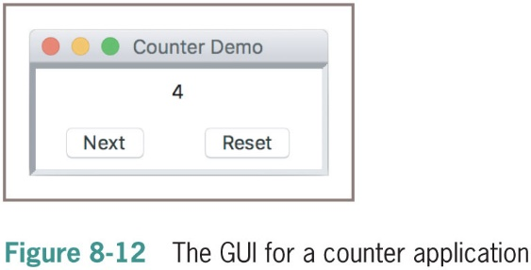
Defining and Using Instance Variables (4 of 4)

Slide 41
Other Useful G U I Resources
Layout of G U I components can be specified in more detail
Groups of components can be nested in panes
Paragraphs can be displayed in scrolling text boxes
Lists of information can be presented for selection in scrolling list boxes as check boxes and radio buttons
G U I-based programs can be configured to respond to various keyboard events and mouse events

Slide 42
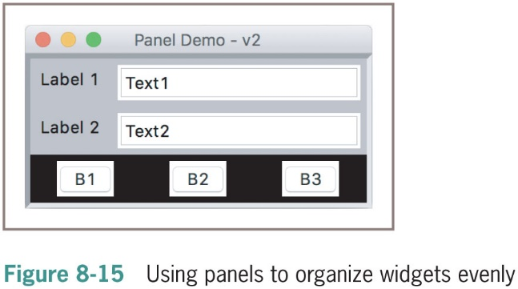
Using Nested Frames to Organize Components (1 of 2)
Code for laying out the G U I shown in Figure 8-15:
class PanelDemo(EasyFrame):
def __init__(self):
# Create the main frame
EasyFrame.__init__(self, “Panel Demo - v2”)
# Create the nested frame for the data panel
dataPanel = self.addPanel(row = 0, column = 0,
background = “gray”)

Slide 43
Using Nested Frames to Organize Components (2 of 2)
Code (continued):
# Create and add widgets to the data panel
dataPanel.addLabel(text = “Label 1”, row = 0, column = 0,
background = “gray”)
dataPanel.addTextField(text = “Text1”, row = 0, column = 1)
dataPanel.addLabel(text = “Label 2”, row = 1, column = 0,
background = “gray”)
dataPanel.addTextField(text = “Text2”, row = 1, column = 1)
#Create the nested frame for the button panel
buttonPanel = self.addPanel(row = 1, column = 0,
background = “black”)
# Create and add buttons to the button panel
buttonPanel.addButton(text = “B1”, row = 0, column = 0)
buttonPanel.addButton(text = “B2”, row = 0, column = 1)
buttonPanel.addButton(text = “B3”, row = 0, column = 2)

Slide 44
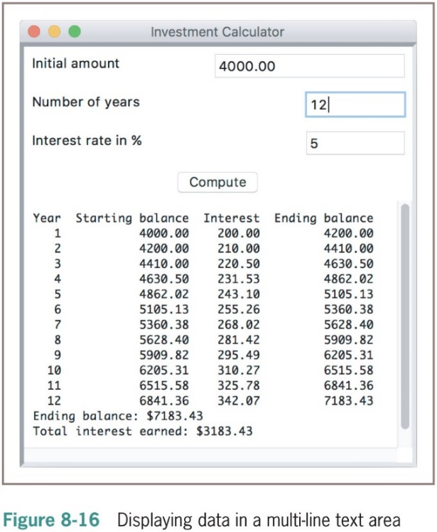
Multi-Line Text Areas (1 of 4)
The method addTextArea adds a text area to the window
Returns an object of type TextArea, a subclass of tkinter.Text
This object recognizes three important methods: getText, setText, and appendText

Slide 45
Multi-Line Text Areas (2 of 4)
class TextAreaDemo(EasyFrame):
“““An investment calculator demonstrates the use of a
multi-line text area. ”””
def __init__(self):
“““Sets up the window and widgets. ”””
EasyFrame.__init__(self, “Investment Calculator”)
self.addLabel(text = “ Initial amount”, row = 0, column = 0)
self.addLabel(text = “ Number of years”, row = 1, column = 0)
self.addLabel(text = “ Interest rate in %”, row = 2, column = 0)
self.amount = self.addFloatField(value = 0.0, row = 0, column = 1)
self.period = self.addIntegerField(value = 0, row = 1, column = 1)
self.rate = self.addIntegerField(value = 0, row = 2, column = 1)

Slide 46
Multi-Line Text Areas (3 of 4)
self.outputArea = self.addTextArea(“ ”, row = 4, column = 0,
columnspan = 2,
width = 50, height = 15)
self.compute = self.addButton(text = “Compute”, row = 3, column = 0,columnspan = 2,command = self.compute)
# Event handling method.
def compute(self):
“““ Computes the investment schedule based on the inputs
and outputs the schedule. ”””
# Obtain and validate the inputs
startBalance = self.amount.getNumber()
rate = self.rate.getNumber() / 100
years = self.period.getNumber()
if startBalance == 0 or rate == 0 or years == 0:
return

Slide 47
Multi-Line Text Areas (4 of 4)
# Set the header for the table
result = “%4s%18s%10s%16s\n” % (“Year”, "Starting balance",
"Interest","Ending balance")
# Compute and append the results for each year
totalInterest = 0.0
for year in range(1, years + 1):
interest = startBalance * rate
endBalance = startBalance + interest
result += "%4d%18.2f%10.2f%16.2f\n" % \
(year, startBalance, interest, endBalance)
startBalance = endBalance
totalInterest += interest
# Append the totals for the period
result += "Ending balance: $%0.2f\n" % endBalance
result += "Total interest earned: $%0.2f\n" % totalInterest
# Output the result while preserving read-only status
self.outputArea["state"] = "normal"
self.outputArea.setText(result)
self.outputArea["state"] = "disabled"

Slide 48
File Dialogs (1 of 2)
G U I-based programs allow the user to browse the computer’s file system with file dialogs
tkinter.filedialog module includes two functions to support file access in G U I-based programs:
askopenfilename and asksaveasfilename
Syntax:
fList = [("Python files", "*.py"), ("Text files", "*.txt")]
filename = tkinter.filedialog.askopenfilename(parent = self,
filetypes = fList)
filename = tkinter.filedialog.ask save as filename(parent = self)

Slide 49
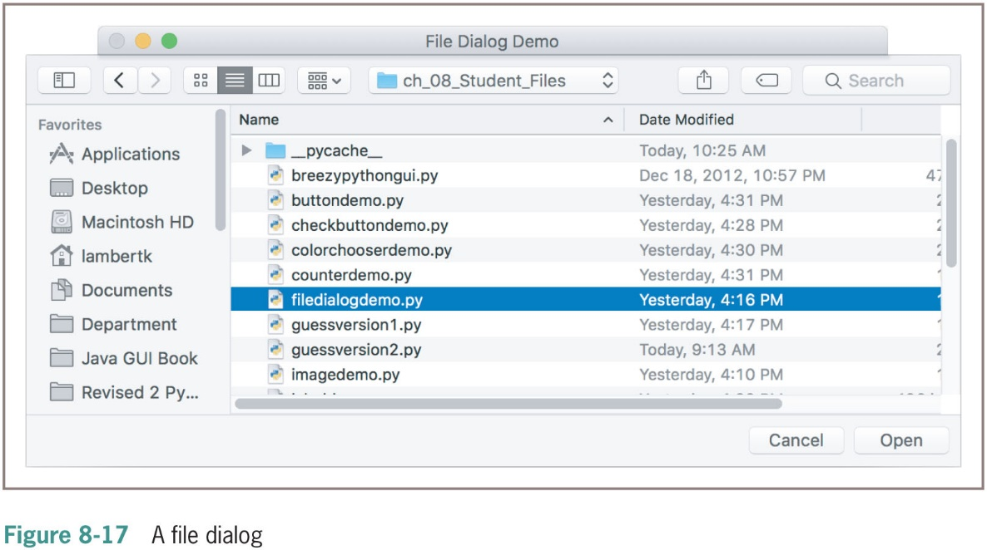
File Dialogs (2 of 2)

Slide 50
Obtaining Input with Prompter Boxes (1 of 2)
class PrompterBoxDemo(EasyFrame):
def __init__(self):
“““ Sets up the window and widgets.”””
EasyFrame.__init__(self, title = "Prompter Box Demo", width = 300, height = 100)
self.label = self.addLabel(text = “ ”, row = 0,
column = 0, sticky = “NSEW”)
self.addButton(text = “Username”, row = 1, column = 0, command = self.getUserName)
def getUserName(self):
text = self.prompterBox(title = “Input Dialog”,
promptString = “Your username:”)
self.label[“text”] = “Hi ” + name + “!”

Slide 51
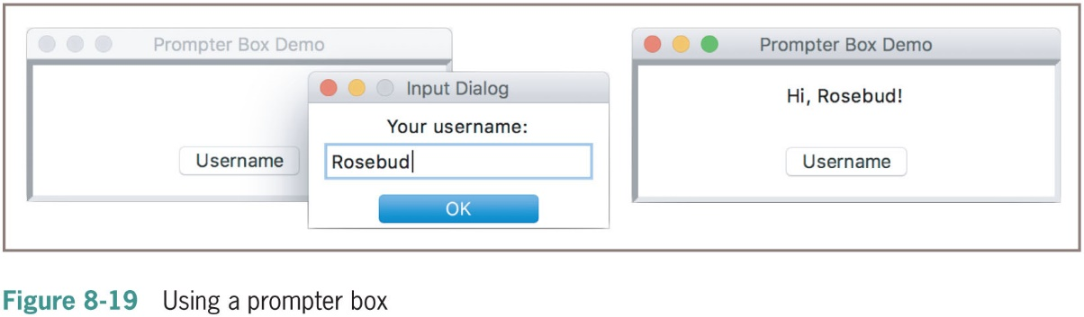
Obtaining Input with Prompter Boxes (2 of 2)

Slide 52
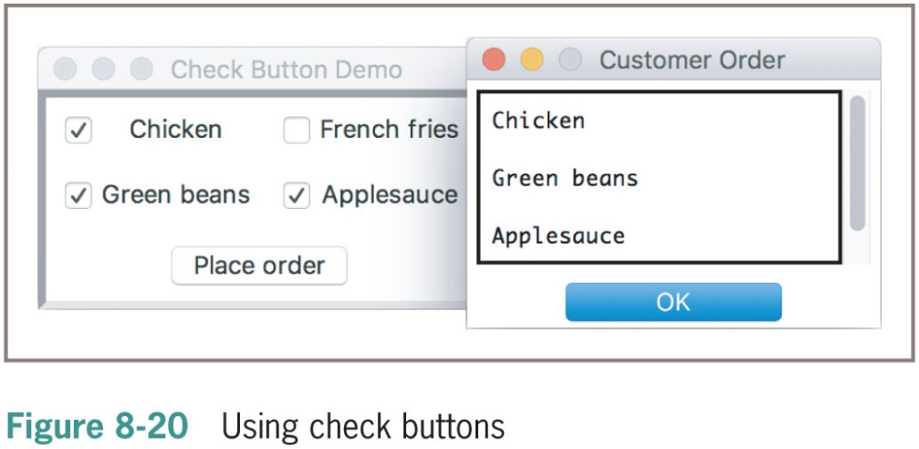
Check Buttons
Check button
Consists of a label and a box that a user can select or deselect with the mouse
The method addCheckbutton expects a text argument and an optional command argument

Slide 53
Radio Buttons (1 of 2)
Radio buttons
Used when the user must be restricted to one selection only
Consists of a label and a control widget
The EasyRadiobuttonGroup method getSelectedButton returns the currently selected radio button in a radio button group
The method setSelectionButton selects a radio button under program control
Once a radio button group is created, the programmer can add radio buttons to it with the EasyRadiobuttonGroup method addRadiobutton
This method expects a text argument and an optional command argument

Slide 54
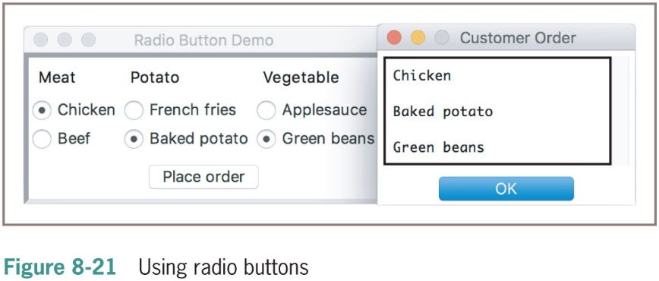
Radio Buttons (2 of 2)

Slide 55
Keyboard Events
You can associate a keyboard event and an event-handling method with a widget by calling the bind method
This method expects a string containing a key event as its first argument and the method to be triggered as its second argument
The string for the return key event is “<Return>”
The event-handling method should have a single parameter named event
You bind the keyboard return event to a handler for the inputField widget:
self.inputField.bind("<Return>",
lambda event: self.computeSqrt())

Slide 56
Working with Colors (1 of 2)
Python represents an R G B value as a string containing a six-digit hexadecimal number
Of the form “0 x R R G G B B”
The tkinter module also accepts the simpler representation “#R R G G B B” for hexadecimal values (called a hex string)

Slide 57
Working with Colors (2 of 2)
Ordinary Value | RGB Triple | Hex String
“black” | (0,0,0) | “#000000”
“red” | (255,0,0) | “#ff0000”
“green” | (0,255,0) | “#00ff00”
“blue” | (0,0,255) | “#0000ff”
“gray” | (127,127,127) | “#7f7f7f”
“white” | (255,255,255) | “#ffffff”

Slide 58
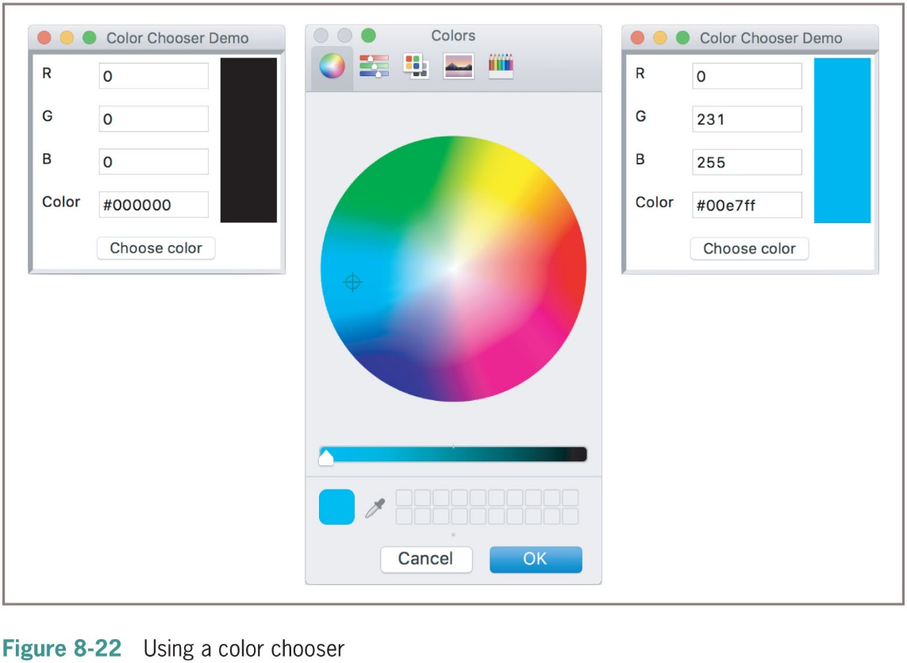
Using a Color Chooser
Most graphics software packages allow the user to pick a color with a standard color chooser

Slide 59
Chapter Summary (1 of 2)
A G U I-based program responds to user events by running methods to perform various tasks
The model/view/controller pattern assigns the roles and responsibilities to three different sets of classes
tkinter and breezy python gui module includes classes, functions, and constants used in G U I programming
A G U I-based program is structured as a main window class (extends the Frame class)
Examples of window components: labels, entry fields, command buttons, text areas, and list boxes

Slide 60
Chapter Summary (2 of 2)
Pop-up dialog boxes display messages and ask yes/no question (tkinter.messagebox module)
Objects can be arranged using grids and panes
Each component has attributes for the foreground color and background color
Text has a type font attribute
The command attribute of a button can be set to a method that handles a button click
Mouse and keyboard events can be associated with handler methods for window objects (bind)

